Slide 1

IT internship presentation
By: Varun Sayal

Slide 2

Past Experience
IT Intern ANSI:
Completed analysis of Dell (Formerly Quest) migration manager for Microsoft SharePoint (QMMSP).
Contributed heavily to the development of ANSI’s data migration project.
Orchestrated technical meetings with Dell repre-sentatives regarding their product.
Contributed to a variety of technical IT meetings.

Slide 3
Project Description
At the time, ANSI was using Microsoft SharePoint 2003 as the front end for their Document Management System.
They wanted to upgrade from 2003 to 2013.
SharePoint has no native upgrade from 2003 to 2013. It only provides 2003 to 2007 upgrade functionality.
ANSI purchased a license for QMMSP which provided this functionality.
They sought to implement this upgrade with as little affect on their consumers as possible.
Some complications existed in relation to this project.

Slide 4
Complications
Concurrently with their SharePoint upgrade, ANSI was undergoing an Identity Management System (IDM) upgrade.
In addition, ANSI also sought to deprecate their outward facing domain (DMZ) due to their impending security upgrade.
The users of SharePoint (Windows Users) were registered in a Microsoft Active Directory (AD) that was affiliated with this soon to be deprecated domain.
The old 2003 SharePoint farm existed on the outward facing domain while the new 2013 farm would live on the internal domain.
In short, this was a Cross Domain, Permissions Preserving, User Migratory, Triple Version SharePoint upgrade.

Slide 5
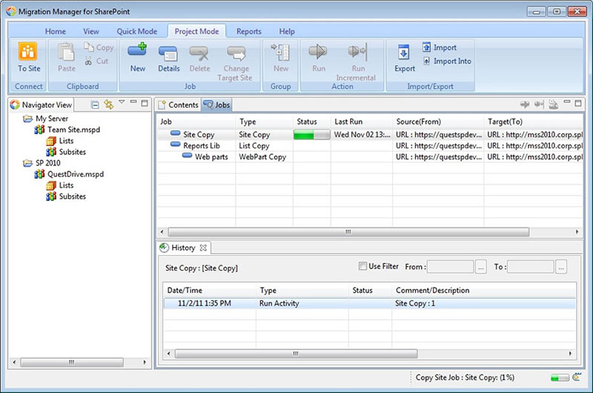
Quest Migration Manager For SharePoint (QMMSP)

Slide 6
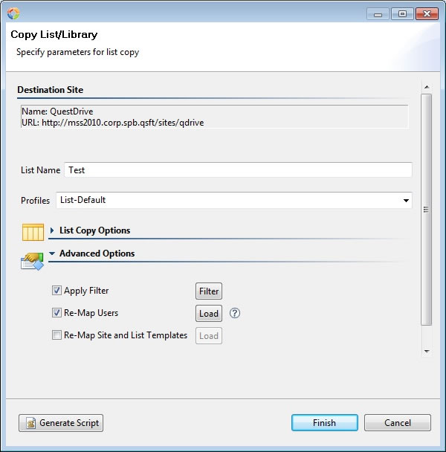
QMMSP cont.

Slide 7
Resolution
During the IDM upgrade, a careful mapping of the Global Unique Identifiers (GUID’s) from the old AD to the new AD would have to be created.
QMMSP would use this mapping (A CSV file), to re-associate document permissions affiliated with users in the old AD to the users in the new AD.
QMMSP would then seamlessly migrate documents from the to-be- deprecated SharePoint farm to the newer farm.
The new farm would have the new Microsoft metro interface as well as the new functionality associated SharePoint 2013.
The project continued after my internship and is nearing completion.

Slide 8

Personal Interest : Bitcoin
Bitcoin is the first, and most well known, form of ‘crypto-currency’.
It is a peer to peer currency transfer network that relies on the principles of cryptography.
It was started in 2009 by one developer under the pseudonym of Satoshi Nakamoto.
One Bitcoin as of 11/19/2013 was worth on average, $705.55. For reference, on 11/16/2013, that number was close to $523.00.
The market cap for Bitcoin, as of 11/19/2013, is 8.4 billion dollars.

Slide 9
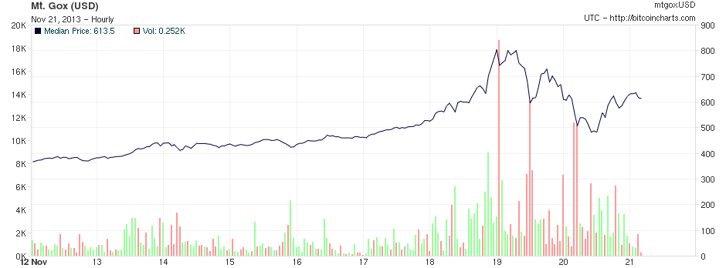
10 Day Bitcoin Price Chart

Slide 10
Bitcoin : How does it work?
Bitcoin is a peer to peer network where creation of Bitcoins is done voluntarily by members of the network.
Bitcoin movement history in this peer to peer network is recorded by something called the ‘Block chain’.
This Block Chain is a record of every transaction ever made within the Bitcoin system, since it’s inception.
In order to create Bitcoins, a miner must create a Block to add to the Block Chain.
Creating a Block is an intentionally CPU intensive task, it is essentially a math problem that can only be solved by guessing the solution repeatedly.
The miner that can solve this problem creates a block and receives a miner reward, thus adding new Bitcoins to the system.

Slide 11
Present Project: Cryptcoin
Cryptcoin is a system implemented by Professor Eugene Stark as part of the Honors programming curriculum.
It emulates closely, the structure and mechanisms associated with Bitcoin including identical Block Chain infrastructure.
As part of our final semester project, we were asked to implement a Cryptcoin wallet similar in functionality to a Bitcoin wallet.

Slide 12
Project Cryptcoin Description
The application must be able to manage and keep track of the currently accepted chain of transactions. This is known as the block chain.
Any received blocks, and their corresponding transactions, must be verified for legitimacy.
Any legitimate transaction funds must be moved from the sender to the receiver.
The Cryptcoin wallet and the GUI interface must reflect these moved funds accurately.

Slide 13
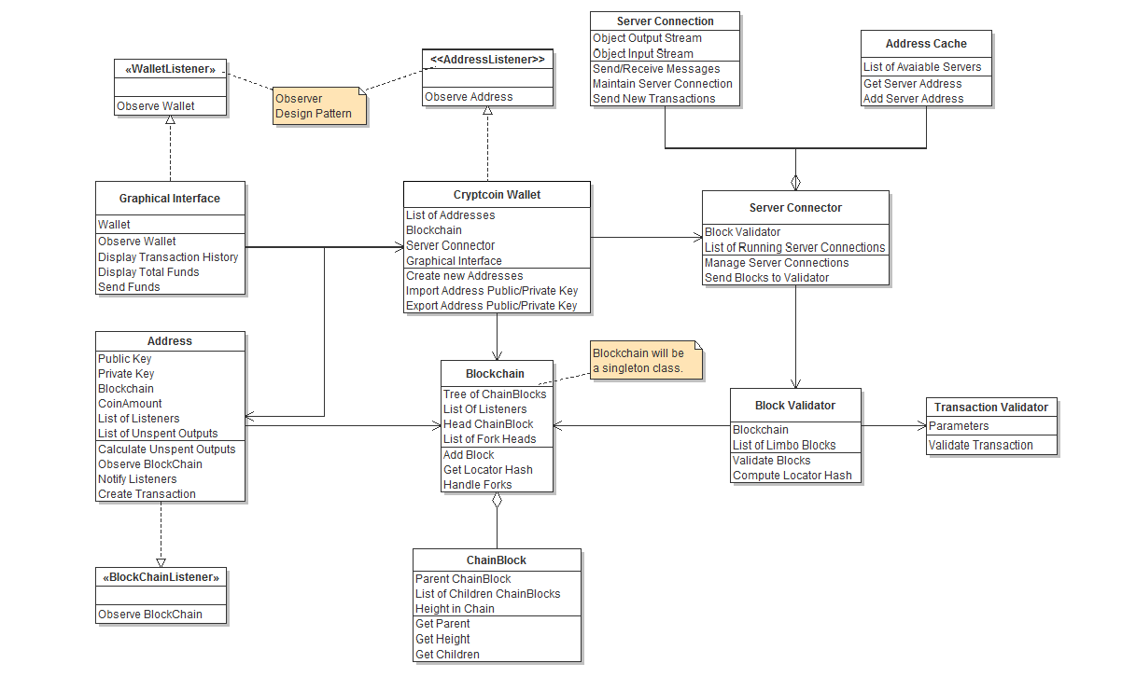

Slide 14
Cryptcoin Cont.
Implemented a beta version of a Cryptcoin wallet.
Incorporated good programming practices including clean implementation of abstraction, and encapsulation techniques.
Functionality includes:
Connecting with servers (Socket Programming).
Tracking the Block Chain.
Verifying legitimate transactions.
Calculating available funds.
Implementing functionality to send and receive Cryptcoin transactions.
Currently at the prototype stage.

Slide 15
Questions?

